Slide 1

ECE 2700
Digital Circuits
Lab Policies &
Introduction to Verilog
Copyright © 2010 Frank Vahid
Instructors of courses requiring Vahid's Digital Design textbook (published by John Wiley and Sons) have permission to modify and use these slides for customary course-related activities, subject to keeping this copyright notice in place and unmodified. These slides may be posted as unanimated pdf versions on publicly-accessible course websites.. PowerPoint source (or pdf with animations) may not be posted to publicly-accessible websites, but may be posted for students on internal protected sites or distributed directly to students by other electronic means. Instructors may make printouts of the slides available to students for a reasonable photocopying charge, without incurring royalties. Any other use requires explicit permission. Instructors may obtain PowerPoint source or obtain special use permissions from Wiley – see http://www.ddvahid.com for information.

Slide 2
Today’s Objective
To know how to implement a simple circuit in Verilog

Slide 3
More on Lab Policies
(In addition to what’s in the syllabus)
Lab 1 due at the end of your session this week
  This is an exception
Other labs due at the beginning of your registered session
  Must be checked out by assigned TA
  (But you can go to any session to get help)
    Though seating is limited and priority is given to students in a given session
Try to use the same workstation every time

Slide 4
Lab Resources
See course website
  At the bottom of front page
  Updated as needed
Verilog mini-reference
  Chapter 6 of the small (secondary) textbook
Verilog tutorial
  Written by Taylor Bybee (a former TA)
  Also on course website

Slide 5
Hints on Labs
Start early
Before you start coding, write out your code on paper and go through it
Be persistent

Slide 6
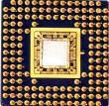




Many Ways to Describe a Digital Circuit
diagrams
natural language
“I will have a nice Saturday if my fridge is full and I get to watch TV all day.”
schematics
TV
Mood
Refrigerator
Which one do you prefer?

Slide 7
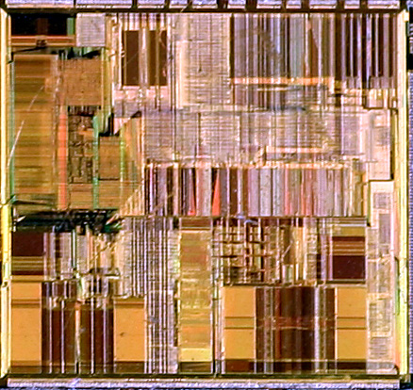
Moore’s Law
IC capacity doubling about every 18 months
  Named after Gordon Moore, co-founder of Intel
  Related phenomena
    For a particular number of transistors, the IC area shrinks by half every 18 months
      Consider how much shrinking occurs in
      just 10 years (try drawing it)
      Enables incredibly powerful computation
      in incredibly tiny devices
  Today’s ICs hold billions of transistors
    The first Pentium processor (early 1990s)
    needed only 3 millions
An Intel Pentium processor IC
having millions of transistors

Slide 8

Transistor Count Trends
Typical digital components per IC
1960s/1970s: 10-1,000
1980s: 1,000-100,000
1990s: Millions
2000s: Billions
100,000
10,000
1,000
Transistors per IC (millions)
100
10
1997
2000
2003
2006
2009
2012
2015
2018

Slide 9
Technology Scaling
More functionality in smaller area
Higher performance
  Reduction in gate delay by about 30%
Lower cost
Better portability

Slide 10
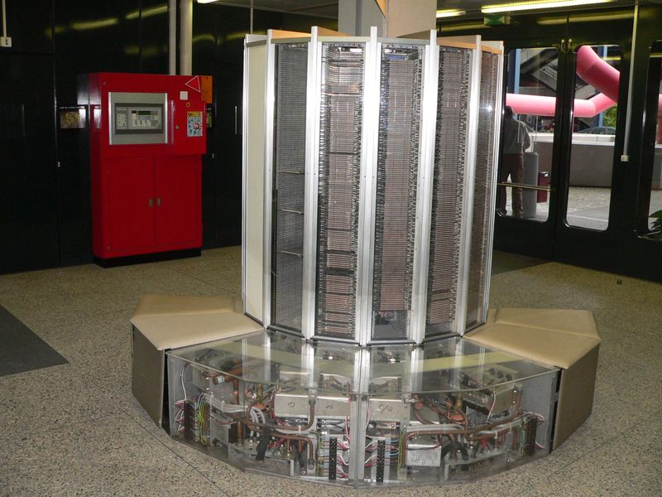
Cray-1 Example
Refrigeration unit that
pumped Freon into
the computer

Slide 11

Another Example
Weight: 15,800g
Price: £1,500
CPU: 500MHz
RAM: 128MB
Storage: 30GB
Weight: 137g
Price: £599
CPU: 1GHz
RAM: 512MB
Storage: 32GB

Slide 12
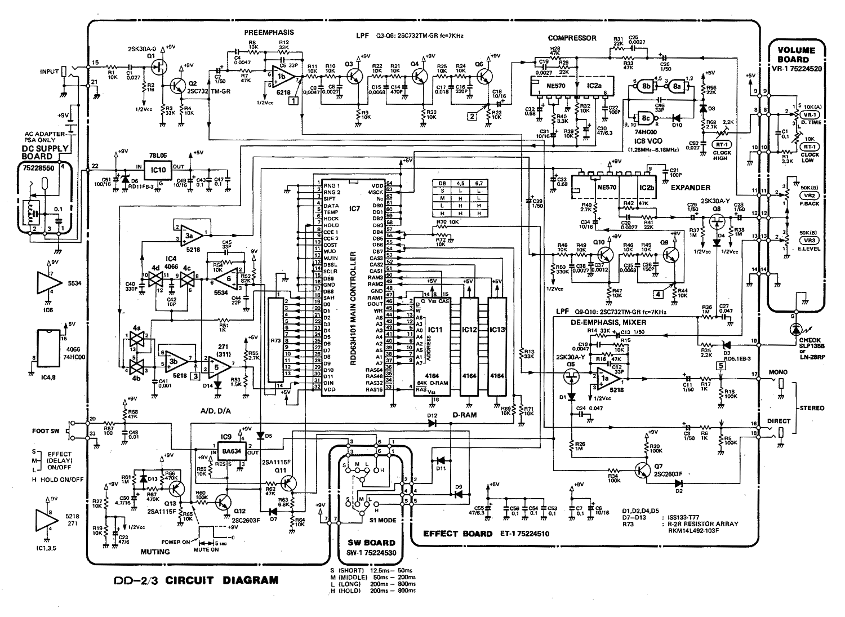
…

Slide 13
Many Ways to Describe a Digital Circuit
diagrams
natural language
“I will have a nice Saturday if my fridge is full and I get to watch football all day.”
schematics
Problems with these techniques
Error-prone
  Hard to reuse/put components together
What if we find out after fabrication that circuit is wrong?
Football
Mood
Refrigerator
Any of these still good for billions transistors?

Slide 14
HDLs
Hardware description languages (HDLs)
  Idea is to describe circuit using code
Machine-readable textual languages for describing hardware
  Text language could be more efficient means of circuit entry than graphical language

Slide 15
HDLs for Simulation
// CombLogic
always @(State, B) begin
case (State)
S_Off: begin
X <= 0;
if (B == 0)
StateNext <= S_Off;
else
StateNext <= S_On1;
end
S_On1: begin
X <= 1;
StateNext <= S_On2;
end
S_On2: begin
X <= 1;
StateNext <= S_On3;
end
S_On3: begin
X <= 1;
StateNext <= S_Off;
end
endcase
end
Clk_s
Rst_s
B_s
X_s
0
30
60
90
120
Simulation

Slide 16
Standardized HDLs
Verilog
  C-like syntax
VHDL
  Ada like
SystemC
  Excels for system-level; cumbersome for logic level
SystemVerilog
  System-level modeling extensions to Verilog

Slide 17
Verilog vs. VHDL
Verilog | VHDL
Weakly-typed | Strongly-typed
Case-sensitive | Case-insensitive
C like | Ada like
More lower-level features | More higher-level features
More features for verification | Intended to be language for documentation only
More libraries

Slide 18
How Does Verilog Work? (1)
Example
Defining a module in Verilog
  module name (port1, port2, …);
  module avg (output1, input1, input2,
  input3);
  *think about: double avg(input1, input2,
  input3)
input1
input1
func-
tion
output1
input2
avg
output1
input2
input3
module
avg module

Slide 19
How Does Verilog Work? (2)
Example
Declare port as either input or output
  input input1, input2, input3;
  output output1;
input and output are 1 bit binary variables
  Value can be 0, 1, or x (unassigned)
  *weakly-typed, like Python
input1
input1
func-
tion
output1
input2
avg
output1
input2
input3
module
avg module

Slide 20
How Does Verilog Work? (3)
Inside the file “avg.v”
  module avg (output1, input1, input2, input3);
    input input1, input2, input3;
    output output1;
    //code to compute average
  end module

Slide 21
Some Notes on Verilog
Verilog is case sensitive
Verilog has several dozen keywords
  module, input, and output are keywords
  Keywords must be lower case
User-defined names – Identifiers, e.g., input1
  Begin with letter or underscore (_), optionally followed by any sequence of letters, digits, underscores, and dollar signs ($)
  Valid identifiers: A, X, Hello, JXYZ, B14, Sig432, Wire_23, _F1, F$2, _Go_$_$, _, Input

Slide 22
Built-In Gates
Verilog has several built-in gates that can be instantiated
  and, or, not, nand, nor, xor, xnor
  One output, one or more inputs (except for not)
  The output is always the first in the list of port connections
Example
  and a1 (out, in1, in2, in3, in4);
  and coolAndGate (out, in1, in2, in3);
Note that gate size is automatically determined by the port connection list

Slide 23
Module Instantiation
Module Instances
input1
input2
and
output1
input1
inputn
input2
output1
input3
and
and
input4
Module
a1
  and a1 (out, in1, in2, in3, in4);
  and coolAndGate (out, in1, in2, in3);
input1
input2
and
output1
input3
coolAndGate

Slide 24
Using Module Instances to Build Circuits
Circuit – a connection of modules
Example: NOT(x) OR y
`timescale 1 ns/1 ns
module somefunction(F, x, y);
input x, y;
output F;
wire N1;
not not1(N1, x);
or or1(F, y, N1);
endmodule
x
y
F

Slide 25
Using Module Instances to Build Circuits
Creating a circuit
  Start definition of a new module
  Declare nets for connecting module instances
  Create module instances and connections
x
y
F
`timescale 1 ns/1 ns
module somefunction(F, x, y);
input x, y;
output F;
wire N1;
not not1(N1, x);
or or1(F, y, N1);
endmodule

Slide 26
Using Module Instances to Build Circuits
Creating a circuit
  Start definition of a new module
  Declare nets for connecting module instances
  Create module instances and connections
x
N1
y
F
`timescale 1 ns/1 ns
module somefunction(F, x, y);
input x, y;
output F;
wire N1;
not not1(N1, x);
or or1(F, y, N1);
endmodule

Slide 27
Using Module Instances to Build Circuits
Creating a circuit
  Start definition of a new module
  Declare nets for connecting module instances
  Create module instances and connections
x
not1
y
or1
F
`timescale 1 ns/1 ns
module somefunction(F, x, y);
input x, y;
output F;
wire N1;
not not1(N1, x);
or or1(F, y, N1);
endmodule

Slide 28
Using Module Instances to Build Circuits
Creating a circuit
  Start definition of a new module
  Declare nets for connecting module instances
  Create module instances and connections
1 ns/1 ns – time unit / time precision. Precision is for internal rounding. For our purposes, precision will be set same as time unit.
x
y
F
`timescale 1 ns/1 ns
module somefunction(F, x, y);
input x, y;
output F;
wire N1;
not not1(N1, x);
or or1(F, y, N1);
endmodule

Slide 29
Example
Creating a circuit
  Start definition of a new module
  Declare nets for connecting module instances
  Create module instances and connections
F = (a AND b) OR (b AND c) or (c AND d)
`timescale 1 ns/1 ns
module somefunction(F, x, y);
input x, y;
output F;
wire N1;
not not1(N1, x);
or or1(F, y, N1);
endmodule

Slide 30
Example
F = (a AND b) OR (b AND c) or (c AND d)
`timescale 1 ns/1 ns
module myfunction(F, a, b, c, d);
input a, b, c, d;
output F;
wire n1, n2, n3;
and a1(n1, a, b);
and a2(n2, b, c);
and a3(n3, c, d);
or o1(F, n1, n2, n3);
endmodule
Ports must be in the same order as in the module definition

Slide 31
Testing Your Design
To make sure design is correct before fabrication
Simulation
  User provides input values, simulator generates output values
`timescale 1 ns/1 ns
module somefunction(F, x, y);
input x, y;
output F;
wire N1;
not not1(N1, x);
or or1(F, y, N1);
endmodule
User provides test vectors (sequence of input values)
1
X
0
1
Y
Simulator generates output values based on HDL description
0
1
F
0
time
Simulator
How do we specify test vectors?

Slide 32
Creating Test Vectors
Describe test vectors with VHDL
1
...
Y_s <= 0; X_s <= 0;
#10 Y_s <= 0; X_s <= 1;
#10 Y_s <= 1; X_s <= 0;
#10 Y_s <= 1; X_s <= 1;
...
X
0
1
Y
0
10
20
30
time
(ns)
`timescale 1 ns/1 ns
module somefunction(F, x, y);
input x, y;
output F;
wire N1;
not not1(N1, x);
or or1(F, y, N1);
endmodule
"#10" –
Tells simulator to keep present values for 10 ns, before executing the next statement

Slide 33
Testing Your Design
To make sure design is correct before fabrication
Simulation
  User provides input values, simulator generates output values
`timescale 1 ns/1 ns
module somefunction(F, x, y);
input x, y;
output F;
wire N1;
not not1(N1, x);
or or1(F, y, N1);
endmodule
...
Y_s <= 0; X_s <= 0;
#10 Y_s <= 0; X_s <= 1;
#10 Y_s <= 1; X_s <= 0;
#10 Y_s <= 1; X_s <= 1;
...
1
F
0
Simulator

Slide 34
Full Testbench Example
Testbench goes into another Verilog file, e.g., testAnd.v
HDL testbench
  Module with no ports
  Declare reg variable for each input port, wire for each output port
  Instantiate module, map variables to ports
  Set variable values at desired times
wire – declares a net data type. A net’s value is determined by what it is connected to
reg – stores value
`timescale 1 ns/1 ns
module Testbench();
reg X_s, Y_s;
wire F_s;
somefunction s1(F_s, x_s, y_s);
initial begin
Y_s <= 0; X_s <= 0;
#10 Y_s <= 0; X_s <= 1;
#10 Y_s <= 1; X_s <= 0;
#10 Y_s <= 1; X_s <= 1;
end
endmodule

Slide 35
Full Testbench Example
Testbench goes into another Verilog file, e.g., testAnd.v
HDL testbench
  Module with no ports
  Declare reg variable for each input port, wire for each output port
  Instantiate module, map variables to ports
  Set variable values at desired times
`timescale 1 ns/1 ns
module Testbench();
reg X_s, Y_s;
wire F_s;
somefunction s1(F_s, x_s, y_s);
initial begin
Y_s <= 0; X_s <= 0;
#10 Y_s <= 0; X_s <= 1;
#10 Y_s <= 1; X_s <= 0;
#10 Y_s <= 1; X_s <= 1;
end
endmodule

Slide 36
Testbench Example
module myfunction(F, a, b, c, d);
`timescale 1 ns/1 ns
module Testbench();
reg X_s, Y_s;
wire F_s;
somefunction s1(F_s, x_s, y_s);
initial begin
Y_s <= 0; X_s <= 0;
#10 Y_s <= 0; X_s <= 1;
#10 Y_s <= 1; X_s <= 0;
#10 Y_s <= 1; X_s <= 1;
end
endmodule

Slide 37
Testbench Example
module myfunction(F, a, b, c, d);
`timescale 1 ns/1 ns
module Testbench();
reg a, b, c, d;
wire F;
myfunction mf(F, a, b, c, d);
initial begin
a <= 0; b <= 0; c <= 0; d <= 0;
#10 a <= 0; b <= 0; c <= 0; d <= 1;
#10 a <= 0; b <= 0; c <= 1; d <= 0;
…
end
endmodule
How many test cases do we have?

Slide 38
Today’s Objective
To know how to implement a simple circuit in Verilog

Slide 39
Question
Implement the following function in Verilog
  F = (b AND c AND NOT(d)) OR a OR NOT(f)

